Slide 1
The Battle of Neighborhoods – Taipei City

Slide 2
Introduction
Being suffered from a combination of political and social issues over past few years, Hong Kong is no longer a place that has a bright future to many. An increasing number of Hong Kong people therefore plan to leave once their beloved home to other places. One of the hottest places is Taipei city, the capital of Taiwan where shares many similarities with Hong Kong (e.g. culture, language and standard of living, etc.) and has a well-established democracy.
Taipei City is a big city and has a lot to offer. It can be daunting to pick where to settle in. In an attempt to provide some useful insights, I am going to explore the neighbourhoods within the city and try to group them according to their characteristics and make suggestions

Slide 3
Data
Foursquare - I will use the Foursquare API to explore neighborhoods in Taipei City. I will use the explore function to get the most common venue categories in each neighborhood, and then use this feature to group the neighborhoods into clusters
Wikipedia - List of neighbourhoods of Taipei

Slide 4
Methodology
Use Nominatim library to find the latitude and longitude values of neighbourhoods of Taipei City
Use the explore function provided by Foursquare to get the most common venue categories for each neighorhood
Use k-means clustering to group the neighborhoods into clusters by the features. This is a very fast and efficient algorithm to perform clustering on unlabeled data.
Use Folium library to visualize the neighborhoods in Taipei City and their clusters

Slide 5
Results
There are three groups:
Group 1: Featuring different kinds of resturants
Group 2: Featuring parks
Group 3: Featuring more diverified venues ranging from convenience store to baseketball to electronics store, etc.

Slide 6
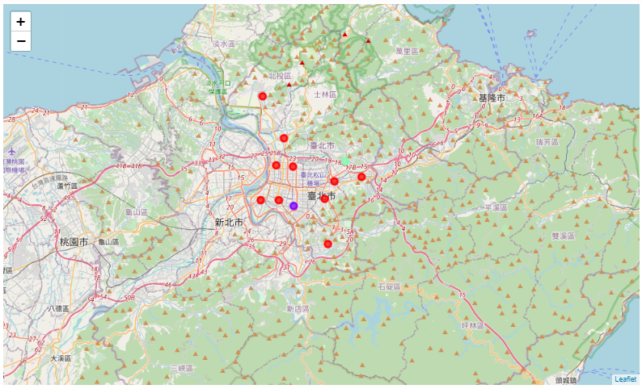
Results (Cont)

Slide 7
Discussion
People can now easily choose the neighborhood that best fit their lifestyle. Group 1 is for those who love eating. Group 2 is for those who love outdoor activities like running, cycling, etc. Group 3 is for those who don't show strong preference to previous two groups.
Apart from knowning the nearby venues, there are other important aspects to consider like rent/housing price, accessiblibty, etc.

Slide 8
Conclusion
Moving to a new place can be very daunting with many uncertainties, however by knowning better about a place beforehand it can become a more confortable and even exciting experience.

